Slide 1
AWS X-Ray

Slide 2
Agenda
What is AWS X-Ray?
How does AWS X-Ray works?
Companies that use AWS X-Ray
Features of AWS X-Ray
Benefits of using it.

Slide 3
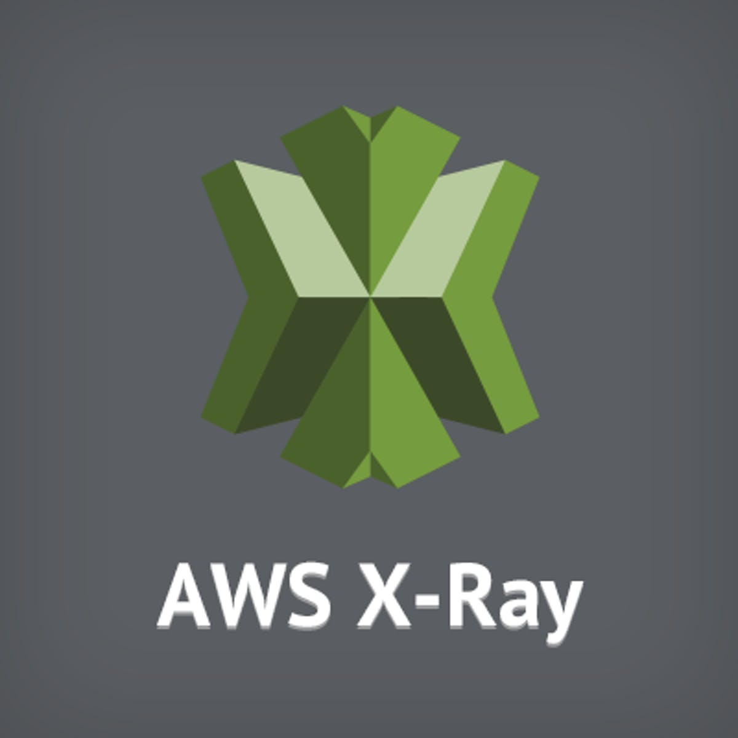
AWS X-Ray
Evaluate and debug distributed applications.
How our application and its underlying services.
Map of our application's underlying components.
Both development and production applications.

Slide 4
How X-Ray works?
Underlying application services it passes through.
Creates traces by combining data.
Service map and get trace data
Latencies, http stats, and metadata.
Investigates concerns and drills down into services.

Slide 5


Companies use X-Ray
Air Asia.
Comcast.
ConnectWise.
Skyscanner.

Slide 6
Features of AWS X-Ray
Simple Setup:
Getting started is simple.
Install the X-Ray agent
Integrating the X-Ray SDK with your application.

Slide 7
Feature of AWS X-Ray
End-to-end tracing:
End-to-end, cross-service view of our application's requests.
Aggregates data
Single unit called a trace.
Single request as it passes through each step.

Slide 8
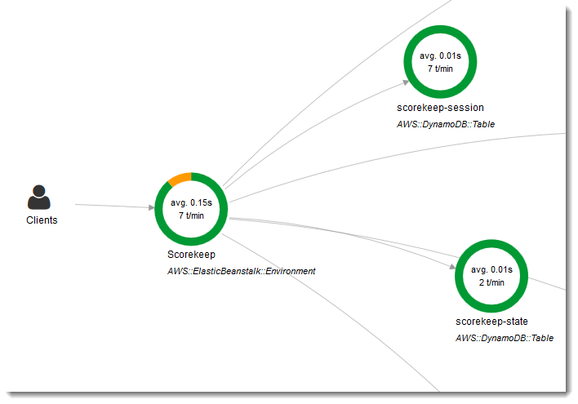
Features of AWS X-Ray
Service map:
Map of application's services.
Complete with trace data.
Between our application's services as well as aggregated data for each service.

Slide 9
Features of AWS X-Ray
Filtering and annotation of data:
Individual components or services.
Filter data for traces based on
Annotation value, average latencies, HTTP response status, timestamp, database table used, etc.

Slide 10
Benefits of X-Ray
Look for problems with your application.
Insights into how your application is behaving.
Root causes with AWS X-Ray.
Tracing and annotations.

Slide 11

Benefits of X-Ray
Enhance the performance:
Detection of performance bottlenecks.
Detect high latencies, visualise node and edge latency distribution for services.

Slide 12
Benefits of X-Ray
Suitable for a wide range of applications:
Basic and complicated applications.
Simple asynchronous event calls.
Three-tier web apps.
Sophisticated microservices applications.

